Slide 1
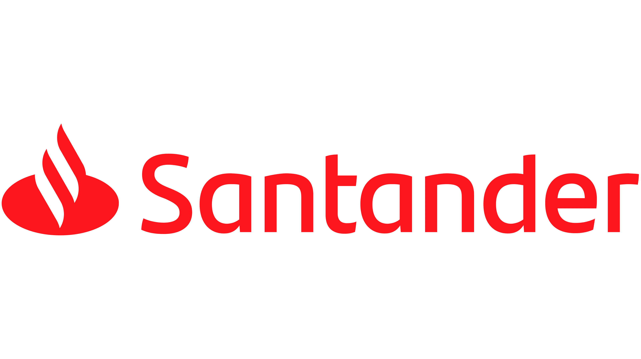
Save+ Powered by
In partnership with Mira Consulting

Slide 2

The team
Afonso Bate 90697
Pedro Marques 93746
João Salgueiro 93725
David Miranda 93697
Tiago Pinto 93187
Pedro Ventura 93155

Slide 3

What we’ve done
Came to a final decision about which idea we will implement;
Developed a Low Fidelity Prototype and used Wizard of Oz in order to obtain user feedback;
Based on user feedback, we produced a Mid Fidelity Prototype;
We again used Wizard of Oz to get user feedback that will be essential moving forward to the High Fidelity Prototype;
Finally, we developed the evaluation plan for the next phase.

Slide 4
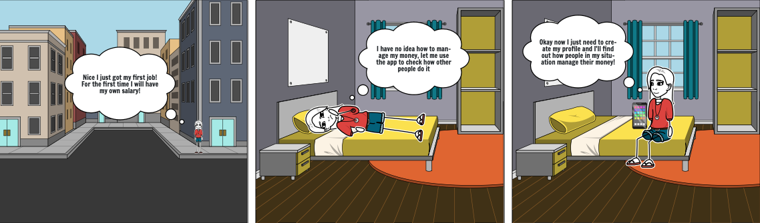
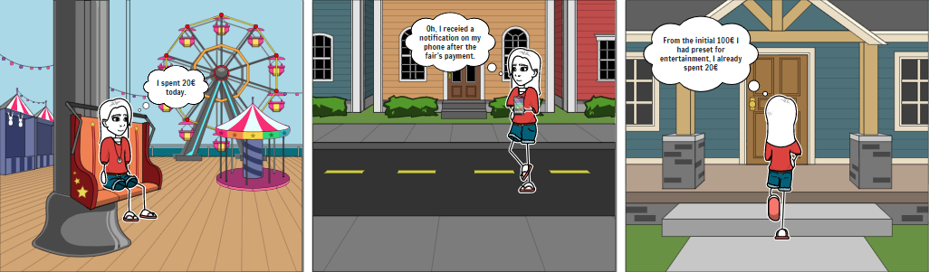
How we started
Idea A
Idea B

Slide 5

Wizard of Oz Tasks
Tasks for A
Tasks for B
Create an account;
Choose the persona that you identify with;
See past movements;
See what you spent during the entire month;
See your progress;
See if there are similar profiles;
Change your persona;
Create an account;
See past movements;
Buy something to get a pop up;
Change budget percentages;

Slide 6
Chosen Idea: A
After all, we chose idea A as the final idea;
There was a possibility of adding the capabilities of the idea B to the one we chose in the future;

Slide 7
Critical Tasks
Choosing a Persona
Choose a budgeting plan that suits your goals
Seeing Past Movements
See what you’ve been spending your money on
Tracking Your Progress
How have you been behaving in regard to your goal

Slide 8
Secondary Tasks
Being able to change your persona;
See users that were successful in reaching their goals and are similar to you

Slide 9
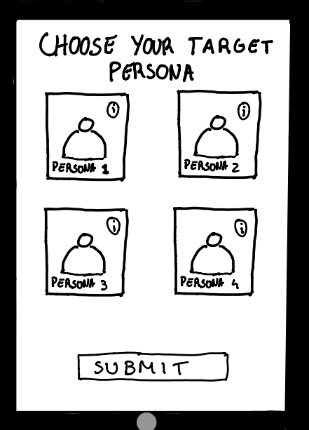
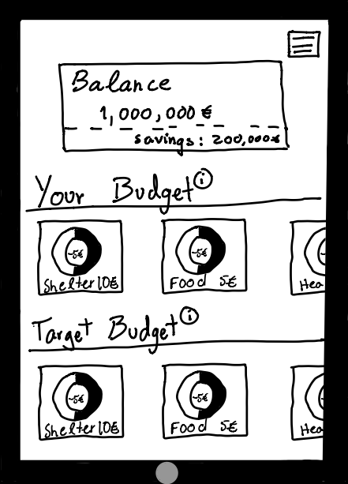
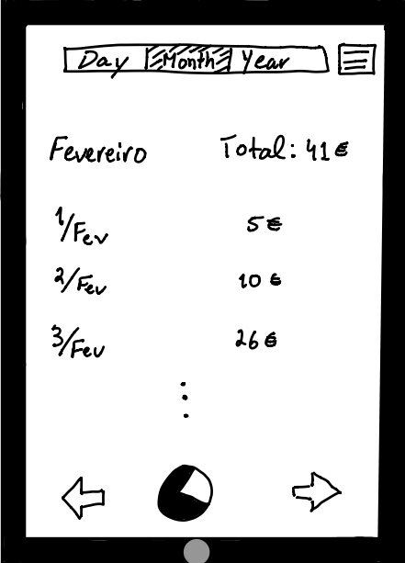
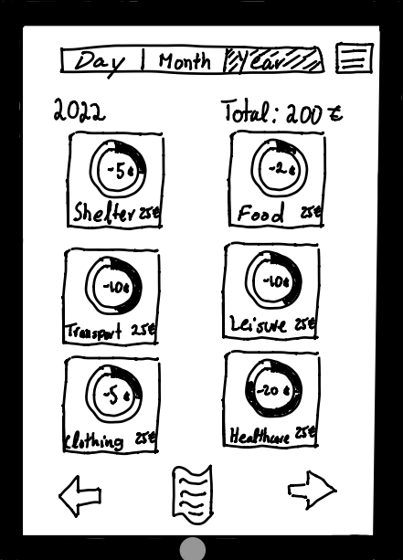
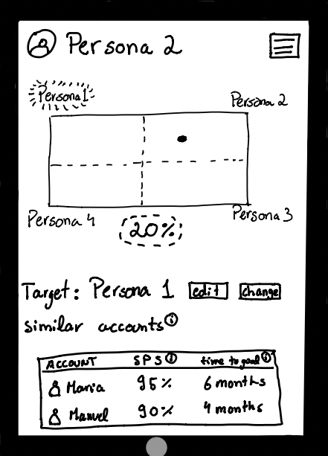
Low Fidelity Prototype

Slide 10
Wizard of Oz Task-set:
Create an account;
See Information about Persona 1;
Choose Persona 1 as your Persona;
See how much you’ve spent in February;
See how much you’ve spent in 2022, as a list;
See how much you’ve spent in 2022, as graphs;
See your progress in regard to your persona;
See if there are similar profiles;
Change your persona to Persona 2;

Slide 11
Wizard of Oz results:
Some users were skipping the part to check information about the persona
Most users were confused by the buttons “edit” and “change” in the “Your Persona” tab
Some users found it difficult to find the menu button

Slide 12
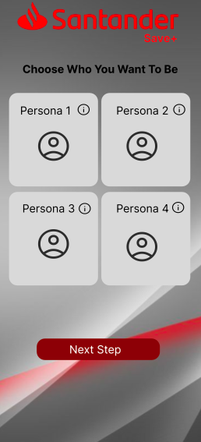
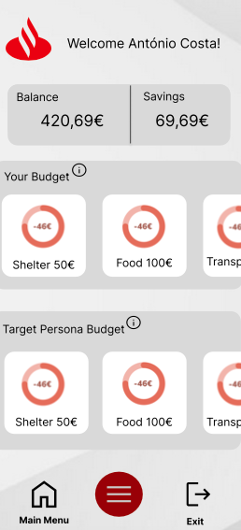
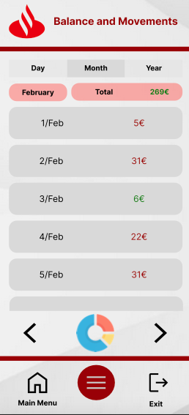
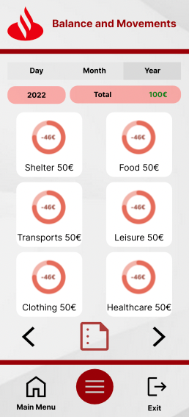
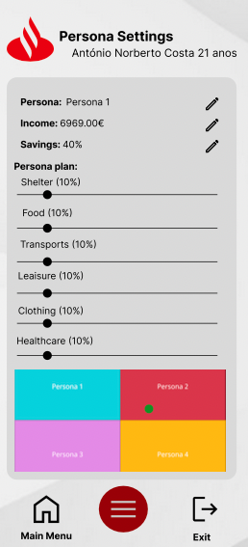
Mid Fidelity Prototype

Slide 13
Wizard of Oz results:
Will be useful to have a confirmation button when someone is choosing/changing the persona
Will be useful to add a button to comeback to the previous page

Slide 14


User Study
Think-Aloud
Interviews
Understand the practicality of our design concept.
Understand how to turn the interface more user-friendly.
Get to know if the problem we are facing is being fully solved.

Slide 15
How to Implement
Think-Aloud
Interviews
Physically places where the problem is most common (universities).
Re-ask questions to people that previously helped with the Wizard of Oz.
Presential or Online
At the universities, ask people that match with our persona.
Re-do the initial interviews to understand if the problem was solved.

Slide 16

Research Questions
User need
Access to the value of the application and if it solves the problem
Suitability
If the design suits the problem
Usability
If the app is user-friendly
Access to your Payments
How easy to access this page
Compare w/ Persona
It’s easy to understand your actual status compared with the chosen persona
Change Persona
If it’s easy to change your persona model

Slide 17
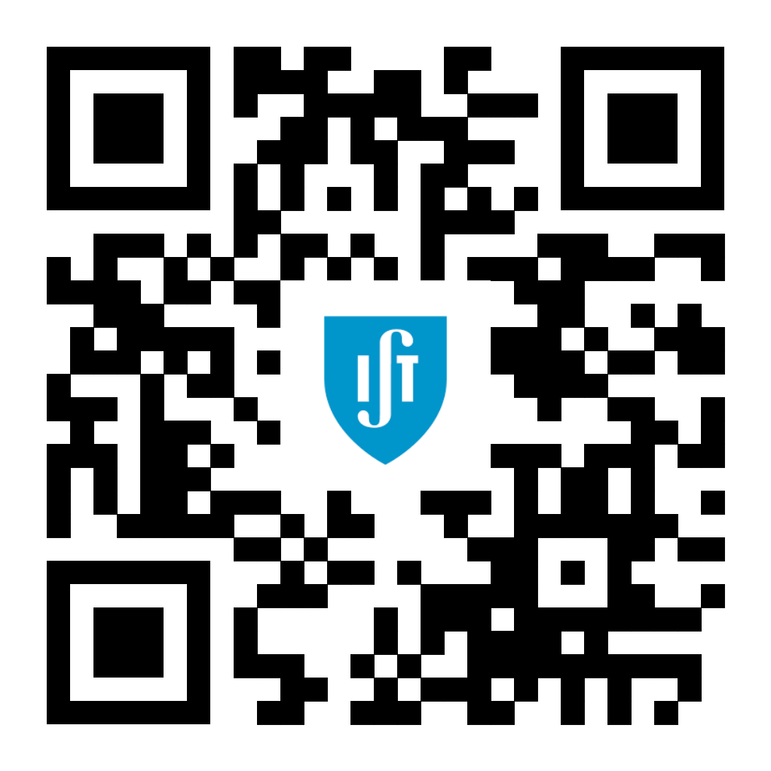
Don’t forget to check our website

